Slide 1
OFFLINE EXERCISES
BUSINESS ANLYTICS PRACTICAL EXERCISE
Presented by: pavithra manikandan

Slide 2
TOPIC 1: Write five user stories for an online food ordering app with clear acceptance criteria User Story 1 – User Registration and Logging
TITLE | USER STORY | ACCEPTANCE CRITERIA | PRIORITY | ESTIMATION | DESCRIPTION
User Registration and Logging | As a new user, I want to register and log in, so that I can securely access my account and use the app’s services. | User can register with valid email and password. Password must be at least 8 characters with one number. Confirmation email is sent after registration. User can log in using correct email and password. Incorrect credentials show an error message. | HIGH | 8 Story Points | This feature allows users to create an account and authenticate using their credentials, ensuring secure access to the app’s feature. It also includes basic validation and error handling.

Slide 3
USER STORY 2 – Browse Restaurants and Menu
TITLE | USER STORY | ACCEPTANCE CRITERIA | PRIORITY | ESTIMATION | DESCRIPTION
Browse restaurants and menu | As a user, I want to browse available restaurants and view their menu, so that I can choose dishes to order. | Restaurants are displayed with name, image, rating and delivery time. Users can filter restaurants by cuisine and rating. Clicking a restaurant shows its full menu. Menu items display name, description, price, and image. Users can search dishes by name | HIGH | 5 Story Points | This feature provides a browsing interface for users to explore restaurants and dishes, helping them make informed choices based on preferences and availability.

Slide 4
USER STORY 3 – Apply Promo codes and Discounts
TITLE | USER STORY | ACCEPTANCE CRITERIA | PRIORTIY | ESTIMATION | DESCRIPTION
Apply promo codes and discounts. | As a user, I want to apply promo codes during checkout, so that I can receive discounts and save money. | Users can enter a promo code at checkout. The system validates the promo code and applies the discount. Invalid or expired promo codes show an error. The final amount reflects the discounted price. The applied promo code is displayed in the order summary. | MEDIUM | 3 Story Points | This feature enables users to apply promotional codes to reduce the total cost of their orders, encouraging repeated usage and customer satisfaction.

Slide 5
USER STORY 4 – Add to Cart and Place Order
TITLE | USER STORY | ACCEPTANCE CRITERIA | PRIORITY | ESTIMATION | DESCRIPTION
Add to cart and place order | As a user, I want to add selected items to my cart and place an order, so that I can easily purchase food. | Users can add or remove items from the cart. The cart shows item details, quantity, and total price. Users can edit quantities in the cart. Users can proceed to checkout with the selected items. A confirmation message appears after successfully placing the order. | HIGH | 8 Story Points | This feature helps users manage their streamline the checkout process, providing a smooth and intuitive ordering experience.

Slide 6
USER STORY 5 – Track Order and Status
TITLE | USER STORY | ACCEPTANCE CRITERIA | PRIORITY | ESTIMATION | DESCRIPTION
Track order and status. | As a user, I want to track the status of my order, so that I can stay informed about when my food will be delivered. | Users can view the order’s current status (received, preparing, out for delivery, delivered). Real time updates are displayed as the order progresses. The delivery time estimate is shown and updated if delayed. A map view shows the delivery person’s location in real time. Users receive notification when the status changes. | MEDIUM | 5 Story Points | This feature allows users to track their order at every stage, ensuring they stay informed and prepared. It improves user experience by providing transparency and timely updates during the delivery process.

Slide 7
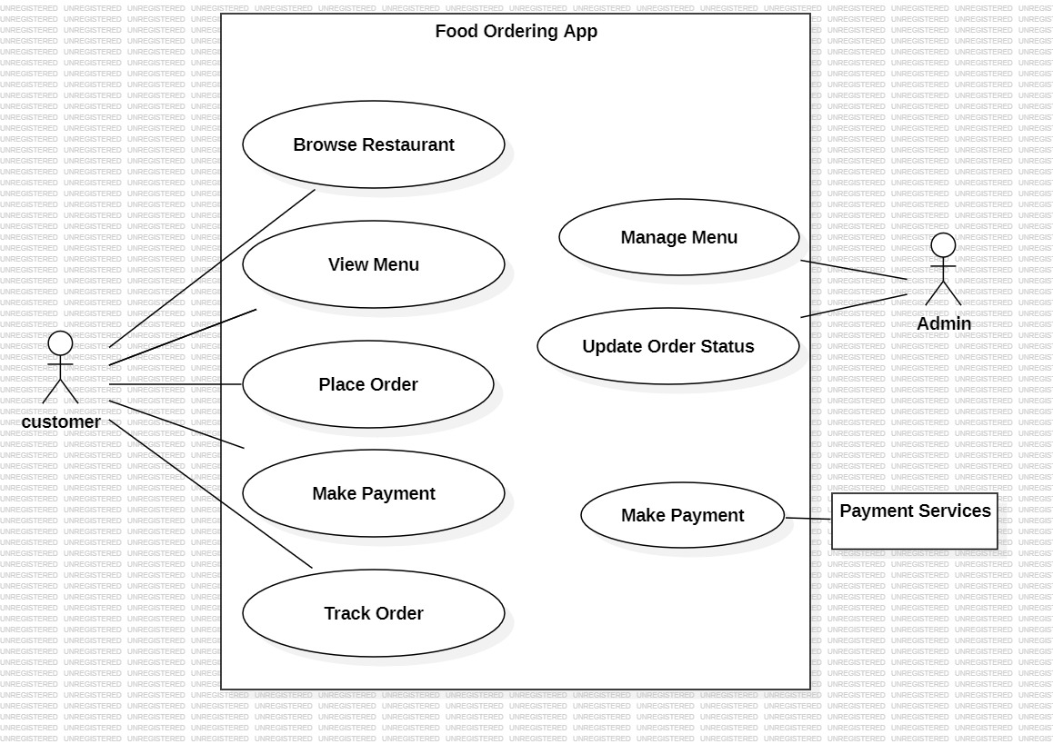
TOPIC 2 - Create a Use Case Diagram & Activity Diagram for the food ordering app
USE CASE DIAGRAM :
The customer interacts with most use cases – browsing restaurants, viewing menus, placing orders, making payments, tracking and receiving orders.
The admin manages the menu and updates order statuses.
The payment service handles secure payments and is connected only to the make payment use case.

Slide 8
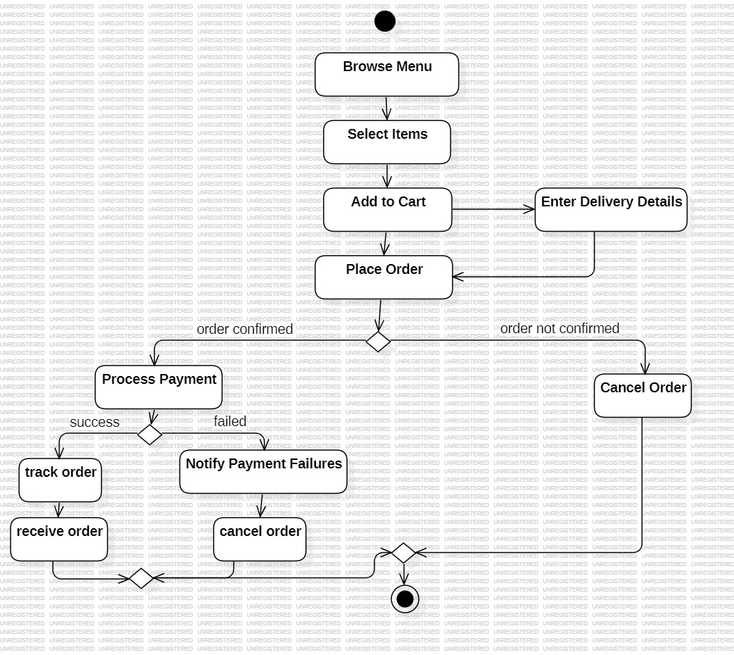
Create an Activity Diagram for the Food Ordering App
ACTIVITY DIAGRAM:
The diagram starts when user opens the app.
Each step is connected by arrows showing the flow.
A decision point handles payment failures.
The process ends when the food is successfully delivered.

Slide 9
TOPIC 3 – Document an API Request – Response flow by analyzing a postman collection
API Request-Response flow:
Client sends the request.
Server processes the request.
Server sends the response.
POSTMAN:
Postman is a widely used tool that simplifies APIs testing and validation
Steps to document API Request-Response flow:
Open the postman collection.
Select the relevant collection (e.g. Food ordering app).
Review each request: endpoint, method (get, post…), headers, parameters, and body.
Choose an API endpoint to document
for example, document the place order API.

Slide 10
Sample API Documentation
API name: Place Order
Method: Post
Endpoint url: https://api.foodapp.com/orders/place
Authentication: Bearer token in authorization header
REQUEST
Headers:
Key - Content type Authorization
Value - Json Bearer token

Slide 11
BODY(JSON):
Json
{ "user Id": "12345",
"restaurant Id": "67890",
"items": [
{ "item Id": "111",
"quantity": 2 },
{ "item Id": "222",
"quantity": 1 }
],
"delivery Address": "123 Main Street, City",
"payment Method": "Credit Card"}
RESPONSE:
Success(200 OK):
Json
{ "order Id": "abc123",
"status": "Order Placed",
"estimated Delivery Time": "30 mins",
"total Amount": 250.75
}
FAILURE(400 Bad Request):
Json
{ "error": "Invalid item ID or quantity"}

Slide 12
Workflow steps:
User selects items from the menu.
User proceeds to checkout and submits the order.
API receives the order details including user id, restaurant id, items, and payment method.
Server processes the order, validates item ids, and stock availability.
Response is sent back with order confirmation or error message.
Error handling:
Missing fields – 400 bad request
Invalid token – 401 unauthorized
Server down – 500 internal server error
Documenting more Endpoints:
API Endpoints
/users/register – user registration
/restaurants/list – fetch available restaurants
/menu/{restaurant Id} – get menu items
/orders/track/{order id} – get current order status
/reviews/add – add a review and rating

Slide 13
TOPIC 4 – Prepare a mock product backlog with prioritized user stories and tasks
PRIORITY | PRODUCT BACKLOG | USER STORY | TASKS
1 | User registration & login | As a new user, I want to register and login, so that I can securely access the app. | Design UI for registration & login, implement backend, authentication – validates inputs(email, passwords), set up token -based authentication.
2 | Browse restaurants | As a user I want to browse restaurant by name, rating, and cuisine, so that I can choose where to order from. | Create restaurant list , API – design restaurant, list page UI – add filter options by cuisine and rating.
3 | View menu | As a user, I want to view a restaurant’s menu, so that I can see available dishes. | Design menu page layout, integrate API to fetch menu items, show dishes details like name, description, price and image.
4 | Add items to cart | As a user, I want to checkout and place an order, so that I can request food delivery. | Design checkout from create order, place API in integrate payment gateway, validate delivery address.

Slide 14
PRIORITY | PRODUCT BACKLOG | USER STORY | TASKS
5 | Place and Track order | As a user, I want to checkout, place order, and track order, so that I can request food delivery and track the status of my order to know when it arrives. | Design checkout form, create order, integrate payment gateway , validate delivery address, create API for order, implement status updates( received, preparing), set out for delivery status and show map and ETA.
6 | Rate and review | As a user, I want to rate and review restaurants, so that I can share feedback. | Create review API implement review UI form, show reviews on restaurant page.
7 | Manage Restaurant | As a restaurant, I want to manage my menu items, so that I can keep offerings updated. | Design menu, manage UI, create CRUD API’S for items, implement image upload feature.
8 | User profile management and push notification | As a user, I want to update my personal details and want to receive order updates via notifications. | Design profile page UI, implement data validation, integrate notification service, design notification UI elements, implement subscription preferences.

Slide 15
Prioritization Reasoning
Must have features (priority 1-3) – user registration, browsing restaurants, and viewing the menu are essential to start using the app.
Core functionality (priority 4-6) – cart, placing orders, and tracking are required for seamless user experience.
Enhancement feature (priority 7-10) – rating, profile management, and notification improve engagement and provide better services but can be added after core functionalities are implemented..
Sample Sprint Planning
Sprint 1 (2 weeks):
Implement user registration & login
Browse restaurants
View menu
Sprint 2 (2 weeks)
Add items to cart
Place order
Review cart UI
Sprint 3 (2 weeks):
Track order status
Rate and review
User profile management
Sprint 4 (2 weeks):
Restaurant menu management
Push notification
UI enhancements

Slide 16
THANK YOU
PRESENTED BY: PAVITHRA MANIKANDAN

